Slide 1
Progress Update
10.20.2026

Slide 2

Part 1: Lippmann-Schwinger to TFA
Goal: I want to express the following TFA equation using Lippmann-Schwinger operators, i.e., define $E_{A}$ and $P_{AB}$ in terms of these operators.
$$ε_{A}=E_{A}:\overline{ε}+\sum_{B}^{ }{P_{AB}:μ_{B}}$$
Reason: I want to explore a TFA-adjacent framework which allows for online FFT-acceleration. If I can express the TFA equation above using the Lippmann-Schwinger operators, it will be easier to perform a clear comparison between the two schemes.

Slide 3
Derivation: LS to TFA (1)
Starting with the constitutive law, compatibility, and equilibrium:
$$σ=C:\left(ε−μ\right)$$
$$ε=\overline{ε}+∇^{s}u$$
$$∇ ⋅σ=0$$
Define a polarization stress (where $C_{0}$ is the stiffness of a homogeneous reference material):
$$τ=σ−C_{0}:ε$$
Rewrite the equilibrium equation with the polarization stress:
$$∇ ⋅\left(τ+C_{0}:ε\right)=0$$

Slide 4
Derivation: LS to TFA (2)
Rearrange the equation to put the polarization stress on the RHS:
$$∇ ⋅\left(C_{0}:ε\right)=−∇ ⋅τ$$
Define the RHS as a force, i.e., $f=−∇ ⋅τ$:
$$∇ ⋅\left(C_{0}:ε\right)=f$$
Because this is a homogeneous material subject to a force $f$, we can employ the Green’s operator:
$$u=G_{0}\left[f\right]$$
We can define the strain as:
$$ε=\overline{ε}+∇^{s}G_{0}\left[f\right]$$

Slide 5
Derivation: LS to TFA (3)
Bring the polarization stress back:
$$ε=\overline{ε}+∇^{s}G_{0}\left[−∇ ⋅τ\right]$$
Then bring the original stress back (and pull the negative sign out):
$$ε=\overline{ε}−∇^{s}G_{0}\left[∇ ⋅\left(σ−C_{0}:ε\right)\right]$$
Define a new operator (expressed acting on some tensor $v$):
$$Γ_{0}\left[v\right]=∇^{s}G_{0}\left[∇ ⋅v\right]$$
Then we have:
This is the Lippmann-Schwinger equation
$$ε=\overline{ε}−Γ_{0}\left[σ−C_{0}:ε\right]$$

Slide 6
Derivation: LS to TFA (4)
Plug in the definition for stress:
$$ε=\overline{ε}−Γ_{0}\left[C:\left(ε−μ\right)−C_{0}:ε\right]$$
Rearrange:
$$ε=\overline{ε}−Γ_{0}\left[\left(C−C_{0}\right):ε−C:μ\right]$$
Move the total strain ($ε$) term to the LHS:
$ε+Γ_{0}\left[\left(C−C_{0}\right):ε\right]=\overline{ε}+Γ_{0}$ $\left[C:μ\right]$
Define a new operator (expressed acting on some tensor $v$):
$$Λ_{0}\left[v\right]=v+Γ_{0}\left[\left(C−C_{0}\right):v\right]$$

Slide 7
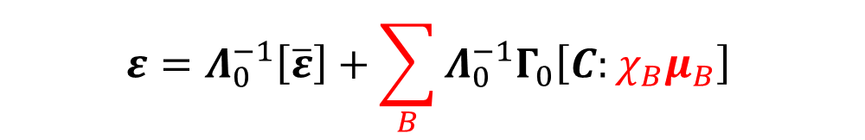
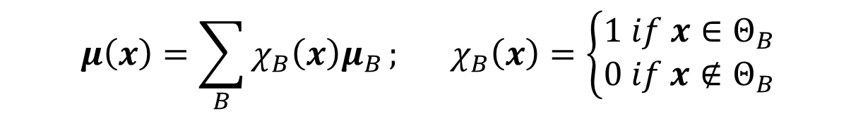
Derivation: LS to TFA (5)
Then we have:
$$Λ_{0}\left[ε\right]=\overline{ε}+Γ_{0} \left[C:μ\right]$$
Assuming the operator $Λ_{0}$ is invertible:
$$ε=Λ_{0}^{−1}\left[\overline{ε}\right]+Λ_{0}^{−1}Γ_{0}\left[C:μ\right]$$
Apply the TFA assumption of constant eigenstrain in partition $B$:
$$μ\left(x\right)=\sum_{B}^{ }{χ_{B}\left(x\right)μ_{B}}; χ_{B}\left(x\right)=\left\{\begin{aligned}1 if x∈Θ_{B} \\ 0 if x∉Θ_{B}\end{aligned}\right.$$
Then we have:
$$ε=Λ_{0}^{−1}\left[\overline{ε}\right]+\sum_{B}^{ }{Λ_{0}^{−1}Γ_{0}\left[C:χ_{B}μ_{B}\right]}$$

Slide 8

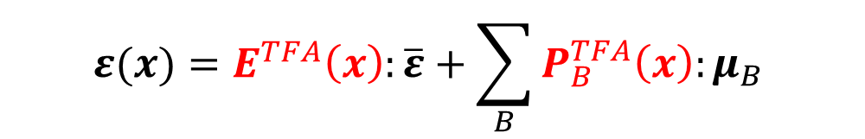
Derivation: LS to TFA (6)
Define two new tensors (expressed acting on some tensor $v$):
$$E^{TFA}\left(x\right):v=\left(Λ_{0}^{−1}\left[v\right]\right)(x)$$
$$P_{B}^{TFA}\left(x\right):v=\left(Λ_{0}^{−1}Γ_{0}\left[C:χ_{B}v\right]\right)(x)$$
Then we have:
$$ε(x)=E^{TFA}\left(x\right):\overline{ε}+\sum_{B}^{ }{P_{B}^{TFA}\left(x\right):μ_{B}}$$
Take the average of both sides over partition $A$:
$$ε_{A}=E_{A}^{TFA}:\overline{ε}+\sum_{B}^{ }{P_{AB}^{TFA}:μ_{B}}$$
This is the TFA form expressed through Lippmann-Schwinger operators !

Slide 9


Derivation: LS to TFA (7, Final)
We now have a clear expression for the $E_{A}$ and $P_{AB}$ TFA tensors in terms of the Lippmann-Schwinger operators:
$$ε_{A}=E_{A}^{TFA}:\overline{ε}+\sum_{B}^{ }{P_{AB}^{TFA}:μ_{B}}$$
Where:
$$E_{A}^{TFA}:v={\left\langle Λ_{0}^{−1}\left[v\right]\right\rangle }_{A}$$
$$P_{AB}^{TFA}:v={\left\langle Λ_{0}^{−1}Γ_{0}\left[C:χ_{B}v\right]\right\rangle }_{A}$$

Slide 10
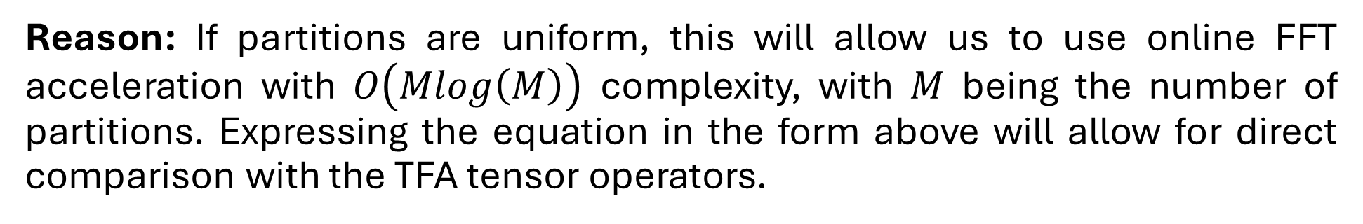
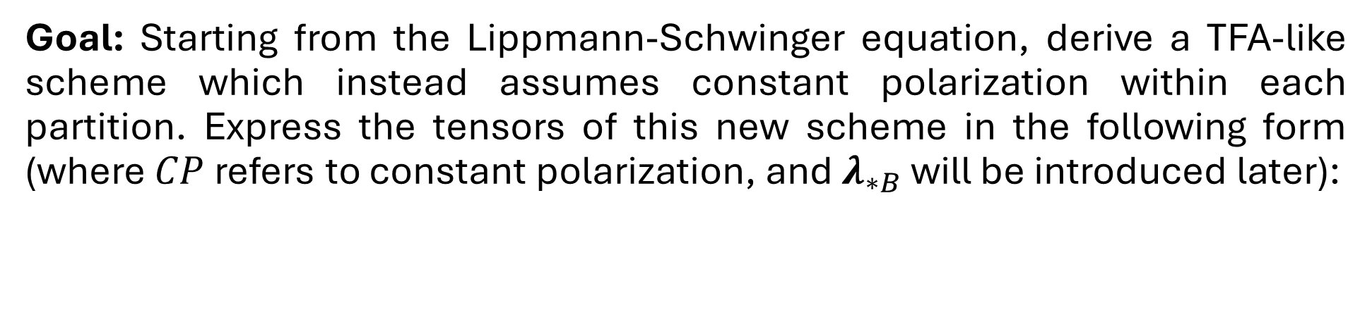

Part 2: Lippmann-Schwinger to Constant Polarization
Goal: Starting from the Lippmann-Schwinger equation, derive a TFA-like scheme which instead assumes constant polarization within each partition. Express the tensors of this new scheme in the following form (where $CP$ refers to constant polarization, and $λ_{∗B}$ will be introduced later):
$$ε_{A}=E_{A}^{CP}:\overline{ε}+\sum_{B}^{ }{P_{AB}^{CP}:λ_{∗B}}$$
Reason: If partitions are uniform, this will allow us to use online FFT acceleration with $O\left(Mlog\left(M\right)\right)$ complexity, with $M$ being the number of partitions. Expressing the equation in the form above will allow for direct comparison with the TFA tensor operators.

Slide 11
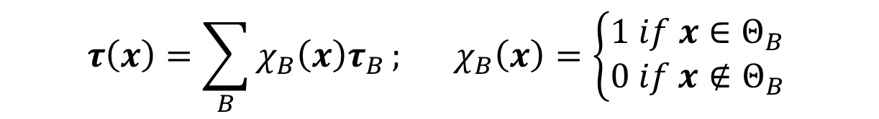
Derivation: LS to CP (1)
Starting with the Lippmann-Schwinger equation:
$$ε=\overline{ε}−Γ_{0}\left[τ\right]$$
Where:
$$τ=\left(C−C_{0}\right):ε−C:μ$$
Apply the assumption of constant polarization stress in partition $B$:
$$τ\left(x\right)=\sum_{B}^{ }{χ_{B}\left(x\right)τ_{B}}; χ_{B}\left(x\right)=\left\{\begin{aligned}1 if x∈Θ_{B} \\ 0 if x∉Θ_{B}\end{aligned}\right.$$

Slide 12
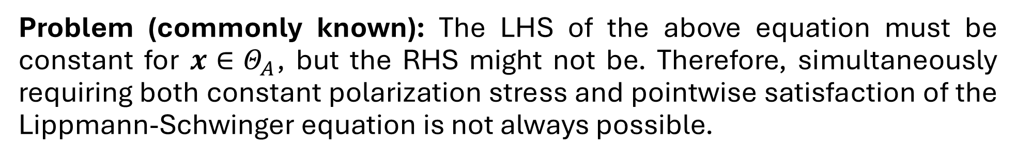
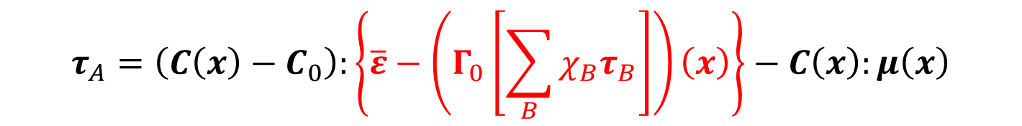
Derivation: LS to CP (2)
From its definition, the polarization stress for some $x∈Θ_{A}$ is expressed as:
$$τ_{A}=\left(C\left(x\right)−C_{0}\right):ε\left(x\right)−C\left(x\right):μ\left(x\right)$$
Plug the Lippmann-Schwinger equation in for $ε\left(x\right)$:
$$τ_{A}=\left(C\left(x\right)−C_{0}\right):\left\{\overline{ε}−\left(Γ_{0}\left[\sum_{B}^{ }{χ_{B}τ_{B}}\right]\right)\left(x\right)\right\}−C\left(x\right):μ\left(x\right)$$
Problem (commonly known): The LHS of the above equation must be constant for $x∈Θ_{A}$, but the RHS might not be. Therefore, simultaneously requiring both constant polarization stress and pointwise satisfaction of the Lippmann-Schwinger equation is not always possible.

Slide 13
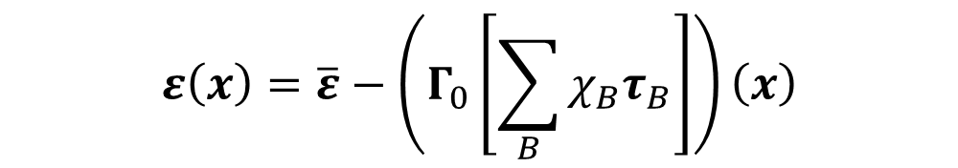

Derivation: LS to CP (3)
Solution (also commonly known): Instead, we can assert that the Lippmann-Schwinger equation be satisfied only through partition averages, a relaxation of the pointwise requirement. So, rather than requiring that:
$$ε\left(x\right)=\overline{ε}−\left(Γ_{0}\left[\sum_{B}^{ }{χ_{B}τ_{B}}\right]\right)\left(x\right)$$
For all $x$, we instead require that:
This is different from the partition averaging of TFA, which is performed after the pointwise Lippmann-Schwinger equation is already satisfied.
$$ε_{A}=\overline{ε}−{\left\langle Γ_{0}\left[\sum_{B}^{ }{χ_{B}τ_{B}}\right]\right\rangle }_{A}$$
Within each partition $A$.

Slide 14
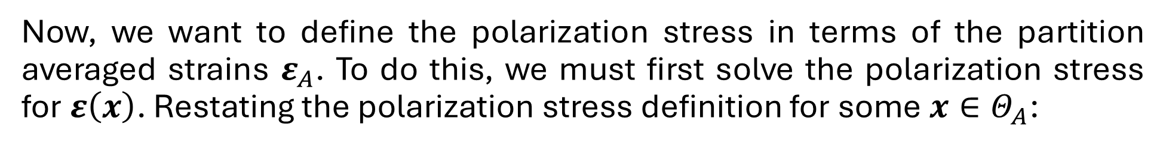
Derivation: LS to CP (4)
Now, we want to define the polarization stress in terms of the partition averaged strains $ε_{A}$. To do this, we must first solve the polarization stress for $ε\left(x\right)$. Restating the polarization stress definition for some $x∈Θ_{A}$:
$$τ_{A}=\left(C\left(x\right)−C_{0}\right):ε\left(x\right)−C\left(x\right):μ\left(x\right)$$
Solve for $ε\left(x\right)$ (assuming we choose the homogeneous reference stiffness such that ${\left(C\left(x\right)−C_{0}\right)}^{−1}$ exists):
$$ε\left(x\right)={\left(C\left(x\right)−C_{0}\right)}^{−1}:\left(τ_{A}+C\left(x\right):μ\left(x\right)\right)$$
Average over partition $A$:
$$ε_{A}={\left\langle {\left(C\left(x\right)−C_{0}\right)}^{−1}\right\rangle }_{A}:τ_{A}+{\left\langle {\left(C\left(x\right)−C_{0}\right)}^{−1}:C\left(x\right):μ\left(x\right)\right\rangle }_{A}$$

Slide 15
Derivation: LS to CP (5)
Then, solve for the polarization stress (assuming ${\left({\left\langle {\left(C\left(x\right)−C_{0}\right)}^{−1}\right\rangle }_{A}\right)}^{−1}$ exists):
$$τ_{A}={\left({\left\langle {\left(C\left(x\right)−C_{0}\right)}^{−1}\right\rangle }_{A}\right)}^{−1}:\left\{ε_{A}−{\left\langle {\left(C\left(x\right)−C_{0}\right)}^{−1}:C\left(x\right):μ\left(x\right)\right\rangle }_{A}\right\}$$
This expression is very messy; we can define some quantities to organize it:
$${C_{∗A}=C_{0}+\left({\left\langle {\left(C\left(x\right)−C_{0}\right)}^{−1}\right\rangle }_{A}\right)}^{−1}$$
There’s probably a good way to explain what these two terms mean physically.
$$λ_{∗A}={\left\langle {\left(C\left(x\right)−C_{0}\right)}^{−1}:C\left(x\right):μ\left(x\right)\right\rangle }_{A}$$
Where the ${\left( ⋅ \right)}_{∗}$ subscript denotes a partition-wise constant field representation. Then, we have:
$$τ_{A}=\left(C_{∗A}−C_{0}\right):\left(ε_{A}−λ_{∗A}\right)$$

Slide 16
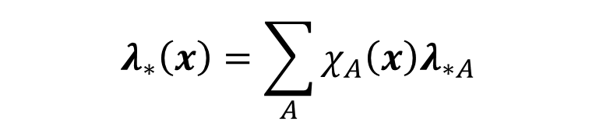
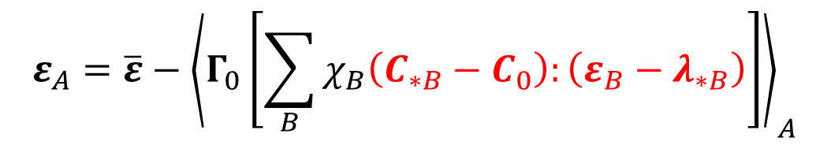
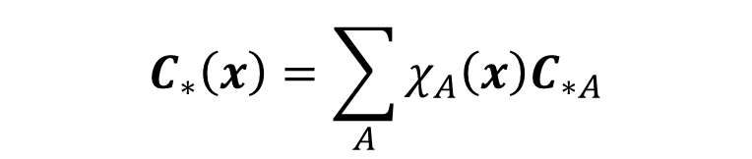

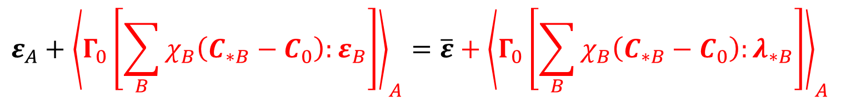
Derivation: LS to CP (6)
Plug this expression back into the partition averaged Lippmann-Schwinger equation:
$$ε_{A}=\overline{ε}−{\left\langle Γ_{0}\left[\sum_{B}^{ }{χ_{B}\left(C_{∗B}−C_{0}\right):\left(ε_{B}−λ_{∗B}\right)}\right]\right\rangle }_{A}$$
Move the total strain $ε$ term to the LHS:
$$ε_{A}+{\left\langle Γ_{0}\left[\sum_{B}^{ }{χ_{B}\left(C_{∗B}−C_{0}\right):ε_{B}}\right]\right\rangle }_{A}=\overline{ε}+{\left\langle Γ_{0}\left[\sum_{B}^{ }{χ_{B}\left(C_{∗B}−C_{0}\right):λ_{∗B}}\right]\right\rangle }_{A}$$
To get rid of the sum notation, we can introduce the following quantities:
$$ε_{∗}\left(x\right)=\sum_{A}^{ }{χ_{A}\left(x\right)ε_{A}}$$
$$C_{∗}\left(x\right)=\sum_{A}^{ }{χ_{A}\left(x\right)C_{∗A}}$$
$$λ_{∗}\left(x\right)=\sum_{A}^{ }{χ_{A}\left(x\right)λ_{∗A}}$$

Slide 17
Derivation: LS to CP (7)
Since the product $χ_{A}χ_{B}=0$ if $A≠B$, we have:
$$ε_{A}+{\left\langle Γ_{0}\left[\left(C_{∗}−C_{0}\right):ε_{∗}\right]\right\rangle }_{A}=\overline{ε}+{\left\langle Γ_{0}\left[\left(C_{∗}−C_{0}\right):λ_{∗}\right]\right\rangle }_{A}$$
To clean the notation a bit, define a new operator:
$$\left(Γ_{∗}\left[v_{∗}\right]\right)\left(x\right)={\left\langle Γ_{0}\left[v_{∗}\right]\right\rangle }_{A}; x∈Θ_{A}$$
Then we have:
$$ε_{∗}+Γ_{∗}\left[\left(C_{∗}−C_{0}\right):ε_{∗}\right]=\overline{ε}+Γ_{∗}\left[\left(C_{∗}−C_{0}\right):λ_{∗}\right]$$

Slide 18
Derivation: LS to CP (8)
Define another new operator (expressed acting on some tensor $v_{∗}$):
$$Λ_{∗}\left[v_{∗}\right]=v_{∗}+Γ_{∗}\left[\left(C_{∗}−C_{0}\right):v_{∗}\right]$$
Then we have:
$$Λ_{∗}\left[ε_{∗}\right]=\overline{ε}+Γ_{∗}\left[\left(C_{∗}−C_{0}\right):λ_{∗}\right]$$
Assuming the operator $Λ_{∗}$is invertible:
$$ε_{∗}=Λ_{∗}^{−1}\left[\overline{ε}\right]+Λ_{∗}^{−1}Γ_{∗}\left[\left(C_{∗}−C_{0}\right):λ_{∗}\right]$$

Slide 19


Derivation: LS to CP (9)
To make the comparison with TFA more explicit, we can plug the definition $λ_{∗}\left(x\right)=\sum_{B}^{ }{χ_{B}\left(x\right)λ_{∗B}}$ back into the previous equation:
$$ε_{∗}=Λ_{∗}^{−1}\left[\overline{ε}\right]+Λ_{∗}^{−1}Γ_{∗}\left[\left(C_{∗}−C_{0}\right):\left(\sum_{B}^{ }{χ_{B}λ_{∗B}}\right)\right]$$
Pull the sum out:
$$ε_{∗}=Λ_{∗}^{−1}\left[\overline{ε}\right]+\sum_{B}^{ }{Λ_{∗}^{−1}Γ_{∗}\left[\left(C_{∗}−C_{0}\right):χ_{B}λ_{∗B}\right]}$$

Slide 20
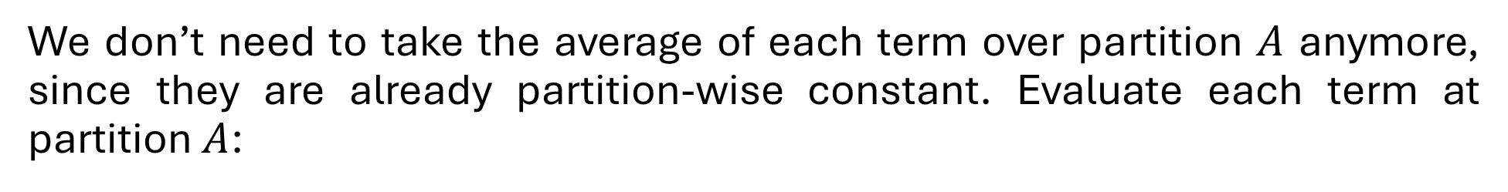

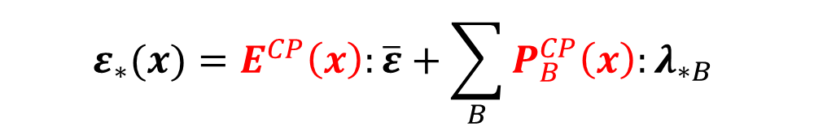
Derivation: LS to CP (10)
Define two new tensors (expressed acting on some tensor $v$):
$$E^{CP}\left(x\right):v=\left(Λ_{∗}^{−1}\left[v\right]\right)(x)$$
$$P_{B}^{CP}\left(x\right):v=\left(Λ_{∗}^{−1}Γ_{∗}\left[\left(C_{∗}−C_{0}\right):χ_{B}v\right]\right)(x)$$
Then we have:
$$ε_{∗}(x)=E^{CP}\left(x\right):\overline{ε}+\sum_{B}^{ }{P_{B}^{CP}\left(x\right):λ_{∗B}}$$
We don’t need to take the average of each term over partition $A$ anymore, since they are already partition-wise constant. Evaluate each term at partition $A$:
$$ε_{A}=E_{A}^{CP}:\overline{ε}+\sum_{B}^{ }{P_{AB}^{CP}:λ_{∗B}}$$
This is a TFA-like form !

Slide 21

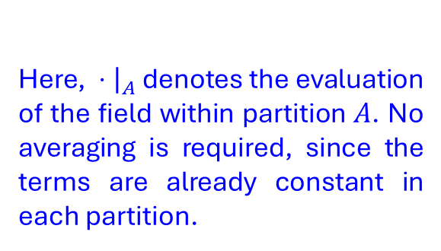


Derivation: LS to CP (11, Final)
We now have a clear expression for the $E_{A}$ and $P_{AB}$ tensors in terms of the Lippmann-Schwinger operators:
$$ε_{A}=E_{A}^{CP}:\overline{ε}+\sum_{B}^{ }{P_{AB}^{CP}:λ_{∗B}}$$
Where:
$$E_{A}^{CP}:v={\left.Λ_{∗}^{−1}\left[v\right]\right|}_{A}$$
Here, ${\left. ⋅ \right|}_{A}$ denotes the evaluation of the field within partition $A$. No averaging is required, since the terms are already constant in each partition.
$$P_{AB}^{CP}:v={\left.Λ_{∗}^{−1}Γ_{∗}\left[\left(C_{∗}−C_{0}\right):χ_{B}v\right]\right|}_{A}$$

Slide 22
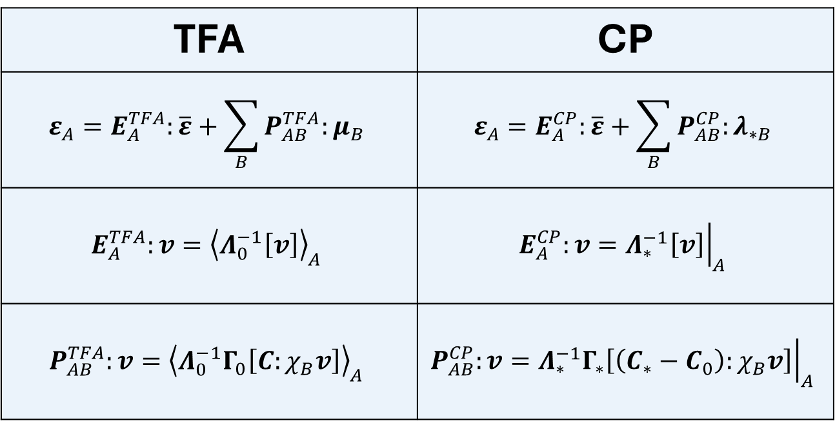
Final Comparison: TFA vs. CP
TFA | CP
$$ε_{A}=E_{A}^{TFA}:\overline{ε}+\sum_{B}^{ }{P_{AB}^{TFA}:μ_{B}}$$ | $$ε_{A}=E_{A}^{CP}:\overline{ε}+\sum_{B}^{ }{P_{AB}^{CP}:λ_{∗B}}$$
$$E_{A}^{TFA}:v={\left\langle Λ_{0}^{−1}\left[v\right]\right\rangle }_{A}$$ | $$E_{A}^{CP}:v={\left.Λ_{∗}^{−1}\left[v\right]\right|}_{A}$$
$$P_{AB}^{TFA}:v={\left\langle Λ_{0}^{−1}Γ_{0}\left[C:χ_{B}v\right]\right\rangle }_{A}$$ | $$P_{AB}^{CP}:v={\left.Λ_{∗}^{−1}Γ_{∗}\left[\left(C_{∗}−C_{0}\right):χ_{B}v\right]\right|}_{A}$$

Slide 23

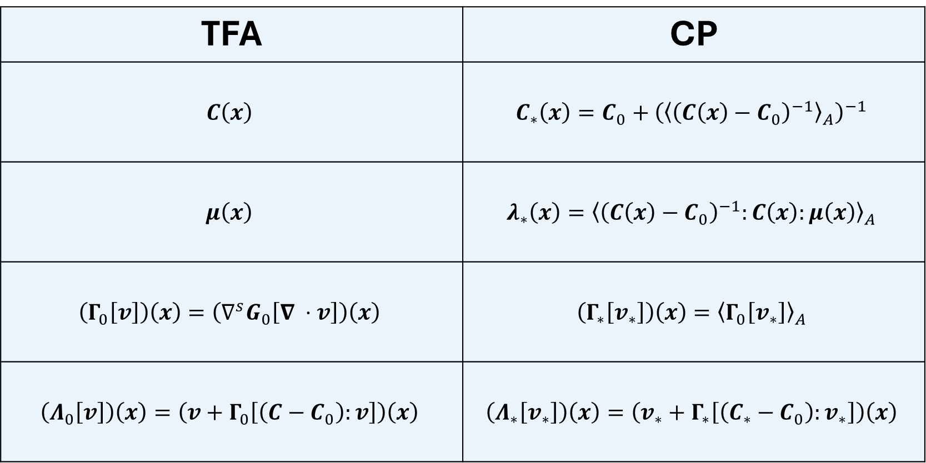
Final Comparison: TFA vs. CP (Operators)
TFA | CP
$$C\left(x\right)$$ | $${C_{∗}\left(x\right)=C_{0}+\left({\left\langle {\left(C\left(x\right)−C_{0}\right)}^{−1}\right\rangle }_{A}\right)}^{−1}$$
$$μ\left(x\right)$$ | $$λ_{∗}\left(x\right)={\left\langle {\left(C\left(x\right)−C_{0}\right)}^{−1}:C\left(x\right):μ\left(x\right)\right\rangle }_{A}$$
$$\left(Γ_{0}\left[v\right]\right)\left(x\right)=\left(∇^{s}G_{0}\left[∇ ⋅v\right]\right)\left(x\right)$$ | $$\left(Γ_{∗}\left[v_{∗}\right]\right)\left(x\right)={\left\langle Γ_{0}\left[v_{∗}\right]\right\rangle }_{A}$$
$$\left(Λ_{0}\left[v\right]\right)\left(x\right)=\left(v+Γ_{0}\left[\left(C−C_{0}\right):v\right]\right)\left(x\right)$$ | $$\left(Λ_{∗}\left[v_{∗}\right]\right)\left(x\right)=\left(v_{∗}+Γ_{∗}\left[\left(C_{∗}−C_{0}\right):v_{∗}\right]\right)\left(x\right)$$
(for $x∈Θ_{A})$

Slide 24
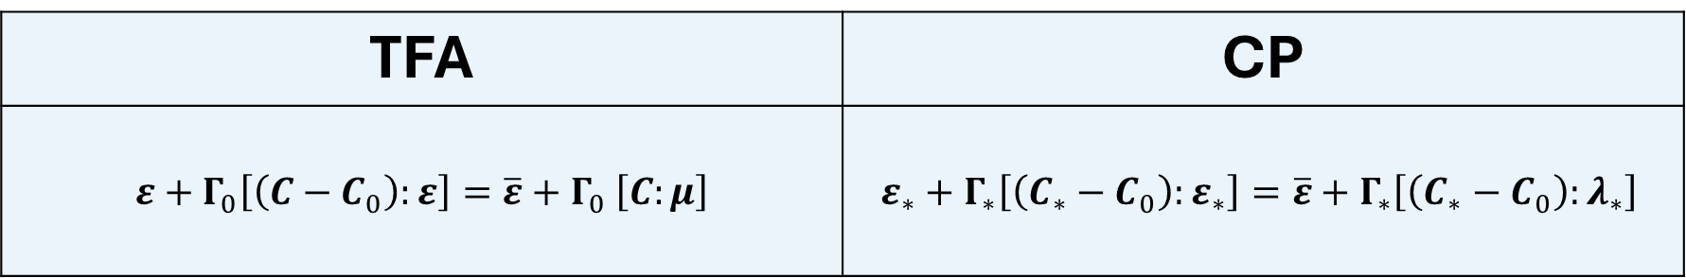
Final Comparison: TFA vs. CP (Lippmann-Schwinger)
TFA | CP
$ε+Γ_{0}\left[\left(C−C_{0}\right):ε\right]=\overline{ε}+Γ_{0}$ $\left[C:μ\right]$ | $$ε_{∗}+Γ_{∗}\left[\left(C_{∗}−C_{0}\right):ε_{∗}\right]=\overline{ε}+Γ_{∗}\left[\left(C_{∗}−C_{0}\right):λ_{∗}\right]$$
To achieve the FFT acceleration, these are the equations we must solve online.

Slide 25
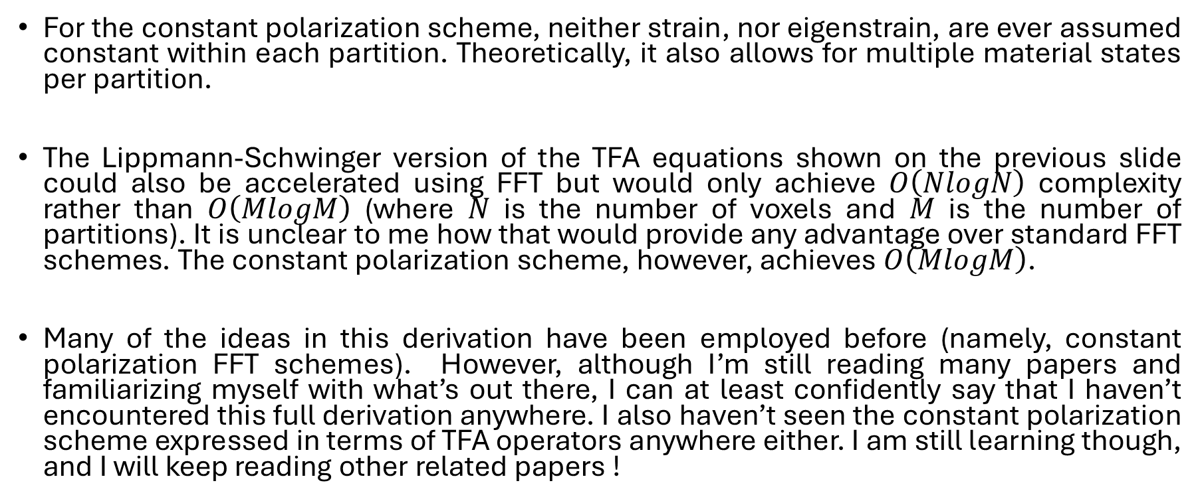
Thoughts
For the constant polarization scheme, neither strain, nor eigenstrain, are ever assumed constant within each partition. Theoretically, it also allows for multiple material states per partition.
The Lippmann-Schwinger version of the TFA equations shown on the previous slide could also be accelerated using FFT but would only achieve $O\left(NlogN\right)$ complexity rather than $O\left(MlogM\right)$ (where $N$ is the number of voxels and $M$ is the number of partitions). It is unclear to me how that would provide any advantage over standard FFT schemes. The constant polarization scheme, however, achieves $O\left(MlogM\right)$.
Many of the ideas in this derivation have been employed before (namely, constant polarization FFT schemes). However, although I’m still reading many papers and familiarizing myself with what’s out there, I can at least confidently say that I haven’t encountered this full derivation anywhere. I also haven’t seen the constant polarization scheme expressed in terms of TFA operators anywhere either. I am still learning though, and I will keep reading other related papers !

Slide 26
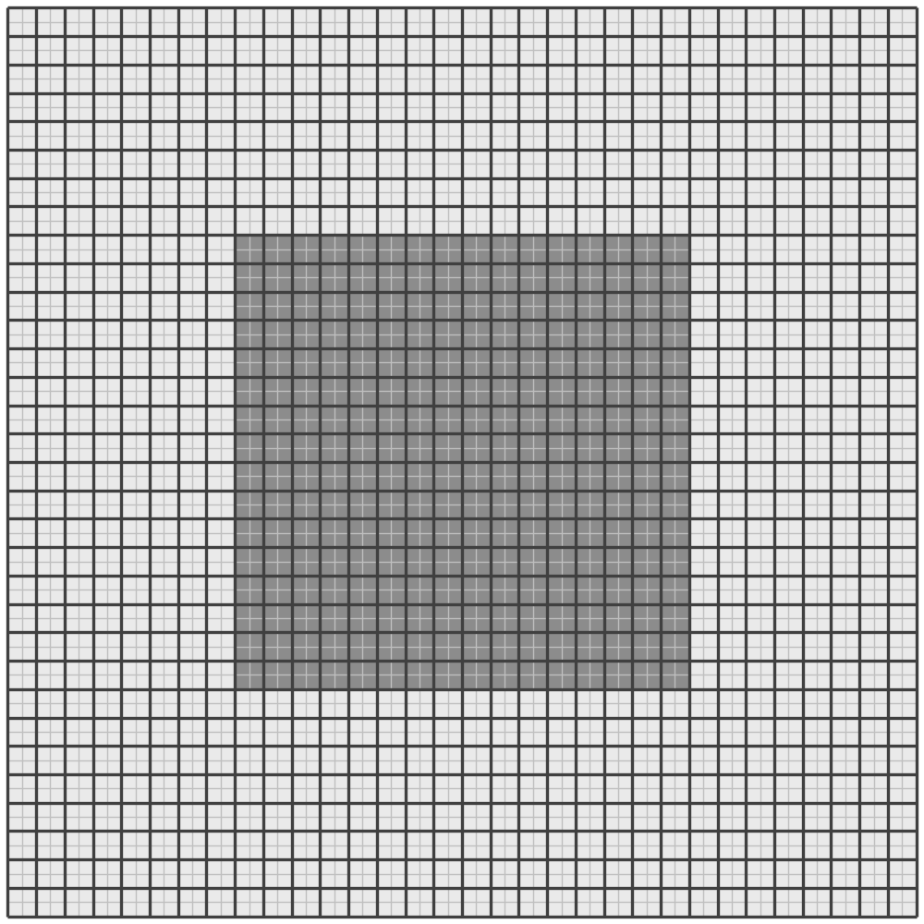
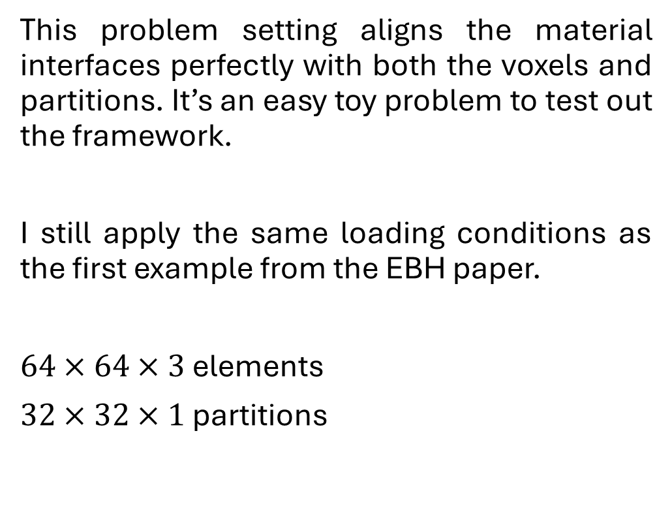
Part 3: Results - Problem Setting
This problem setting aligns the material interfaces perfectly with both the voxels and partitions. It’s an easy toy problem to test out the framework.
I still apply the same loading conditions as the first example from the EBH paper.
$64×64×3$ elements
$32×32×1$ partitions

Slide 27
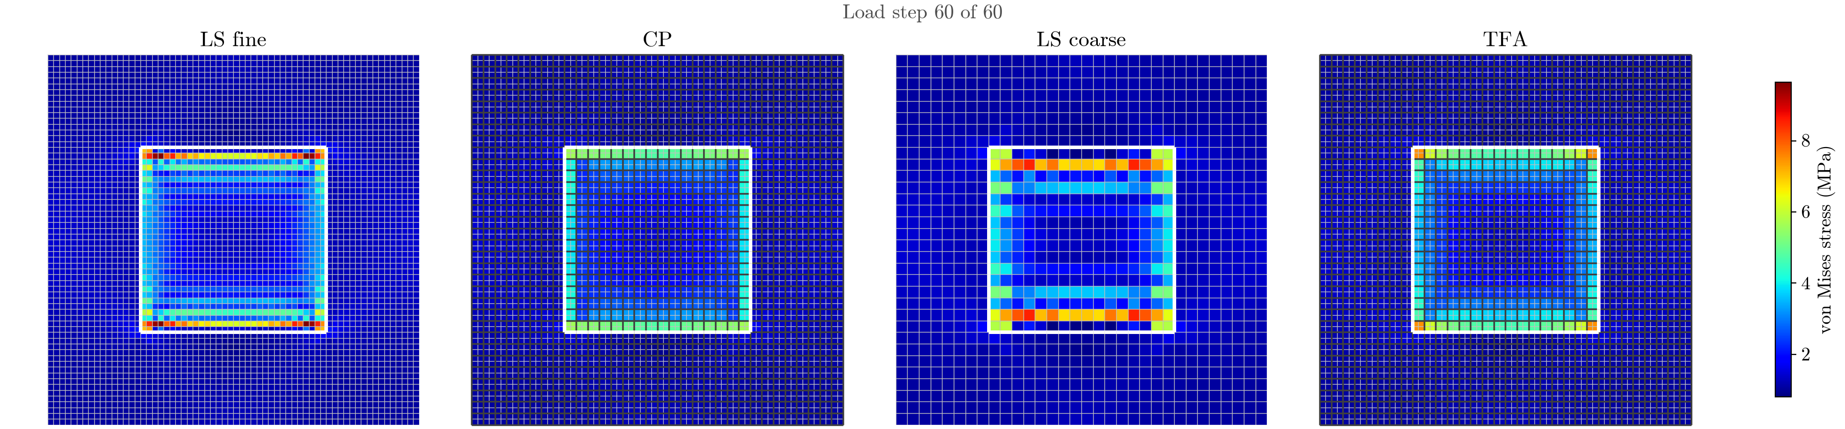
Results - Stress Contour
Basic FFT solver on the fine grid.
The proposed constant polarization scheme.
Basic FFT solver on the coarse grid.
Standard TFA scheme.
I compare with the basic FFT schemes. They are known for strong ringing near the material interfaces. There are more complex schemes that improve this, I just haven’t implemented them.

Slide 28
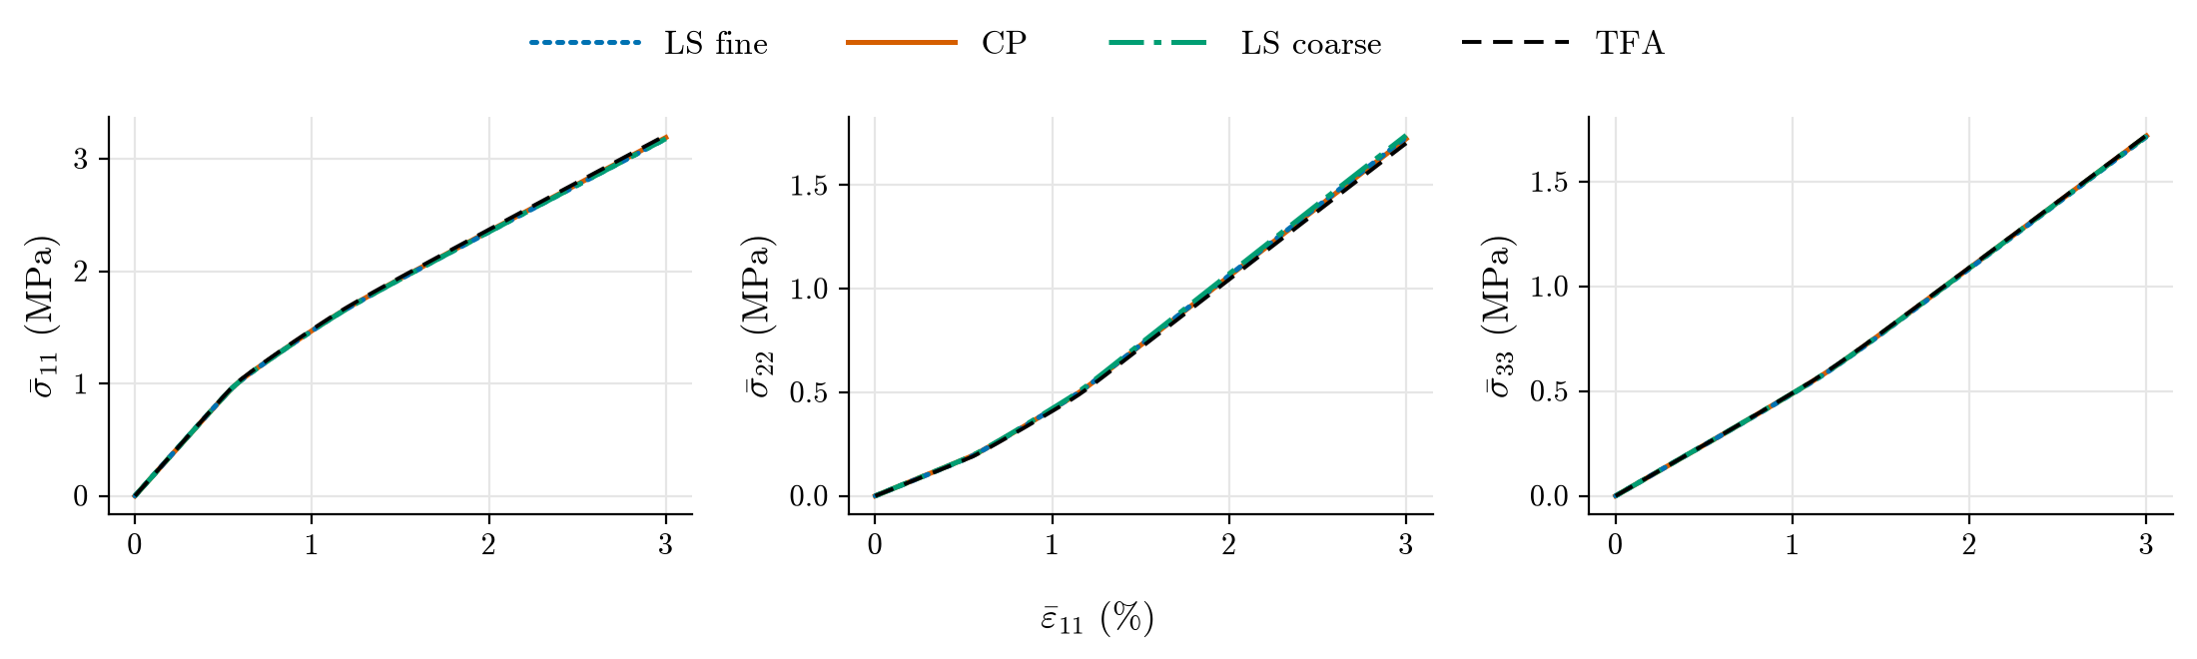
Results - Stress-Strain Curve
They all seem to perform similarly.

Slide 29
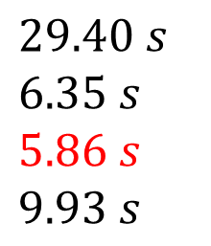
Results - Timing Comparison
I calculated the average online time of 5 runs for each scheme. The results are as follows:
Fine grid FFT:
Coarse grid FFT:
Proposed constant polarization:
TFA:
$$29.40 s$$
$$6.35 s$$
$$5.86 s$$
$$9.93 s$$
The constant polarization scheme is the fastest. The gains vs. TFA and the fine grid FFT solver only improve as the number of partitions increases.
Note: TFA performs the best, by far, for smaller partition counts.

Slide 30
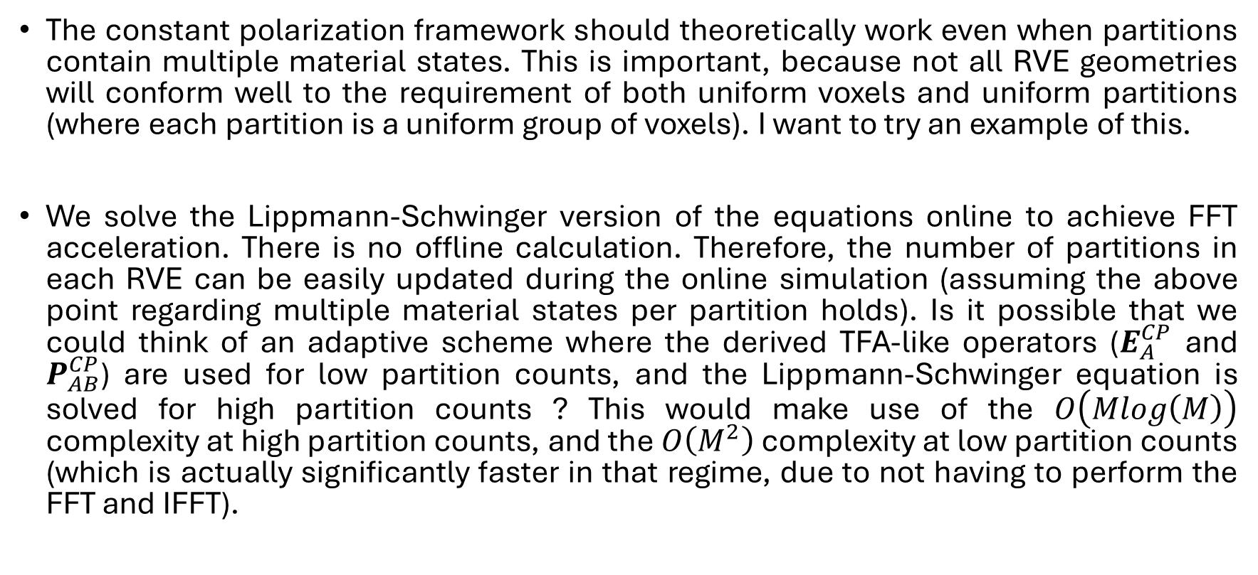
Closing Thoughts / Going Forward
The constant polarization framework should theoretically work even when partitions contain multiple material states. This is important, because not all RVE geometries will conform well to the requirement of both uniform voxels and uniform partitions (where each partition is a uniform group of voxels). I want to try an example of this.
We solve the Lippmann-Schwinger version of the equations online to achieve FFT acceleration. There is no offline calculation. Therefore, the number of partitions in each RVE can be easily updated during the online simulation (assuming the above point regarding multiple material states per partition holds). Is it possible that we could think of an adaptive scheme where the derived TFA-like operators ($E_{A}^{CP}$ and $P_{AB}^{CP}$) are used for low partition counts, and the Lippmann-Schwinger equation is solved for high partition counts ? This would make use of the $O\left(Mlog\left(M\right)\right)$ complexity at high partition counts, and the $O\left(M^{2}\right)$ complexity at low partition counts (which is actually significantly faster in that regime, due to not having to perform the FFT and IFFT).

Slide 31
Thanks !

